Slide 1
Working material for this workshop
Single_read.fastq
Bacteria_GATTACA_L001_R1_001.fastq
Adapter_Sequence.fasta
rDNA_sequence.fasta
rDNA.gtf
all_steps.sh
Please register on Galaxy, activate account and login!
https://usegalaxy.org/login
If you have an account on UCSF Wynton HPC cluster please try to login using instructions at https://wynton.ucsf.edu/hpc/get-started/access-cluster.html

Slide 2
Introduction to RNA-seq data analysis
Michela Traglia, Ayushi Agrawal
Bioinformatics Core, GIDB
March 10-11, 2022

Slide 3
Introductions
Michela Traglia
Statistician III
Ayushi Agrawal
Bioinformatician II

Slide 4
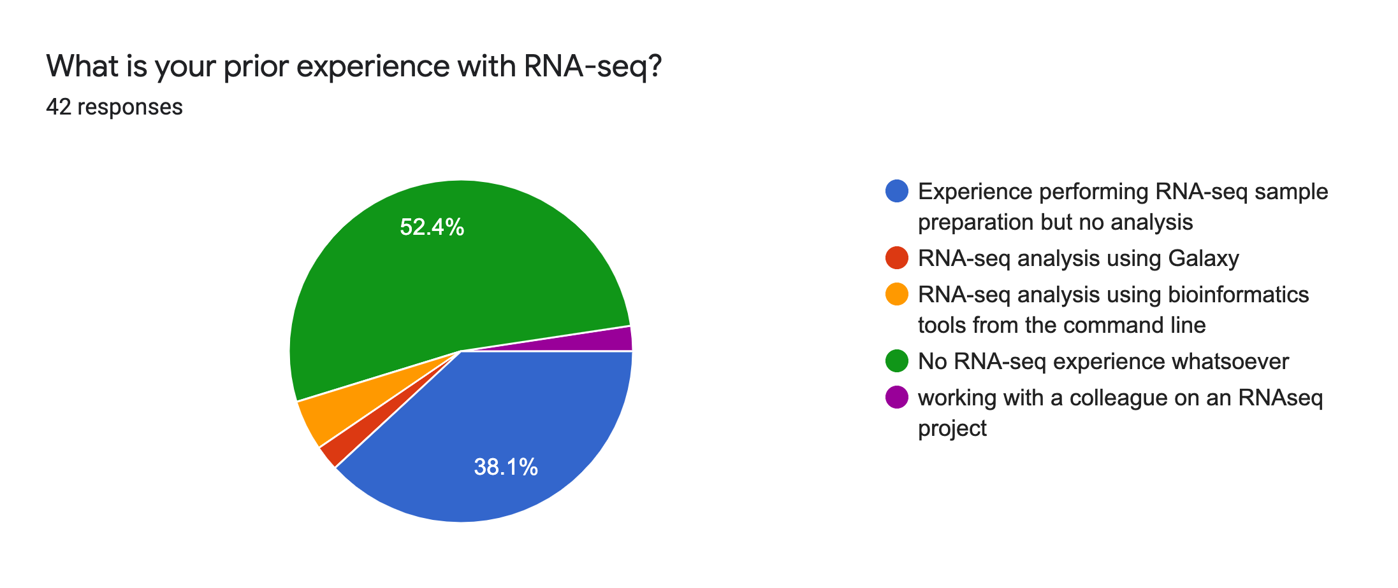
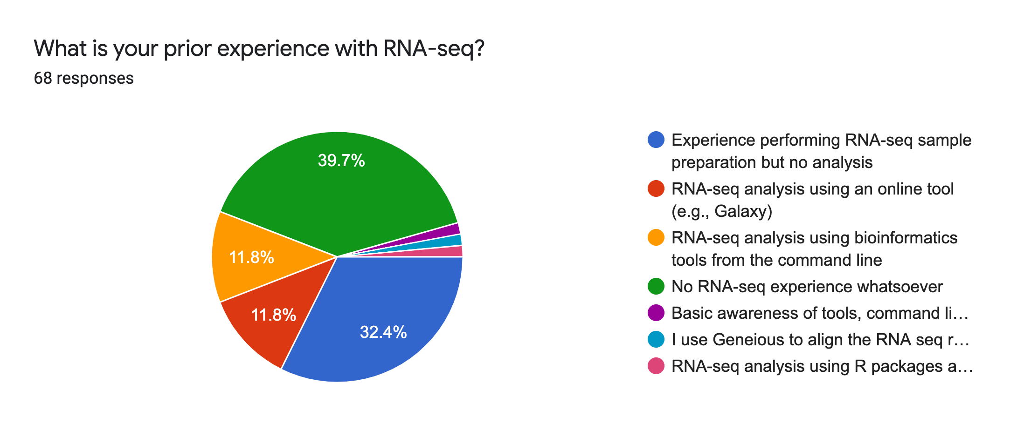
Expectations for the workshop

Slide 5
Goals
By the end of this workshop you should be able to:
Demystify each step of the RNA-Seq data analysis
Understand the bioinformatic pipeline from raw data
Enable informed conversations with computational biologists
Demonstrate how to analyze data using a graphical user interface (Galaxy) and a high-performance compute (HPC) cluster (Wynton)
Notes:
This slide deck gives an overview of the tools and tech underlying RNA-seq.
Galaxy is an open source, web-based platform for data intensive biomedical research. There are helpful tutorials to get started with Galaxy on https://training.galaxyproject.org/training-material/ .
What is an HPC? https://insidehpc.com/hpc-basic-training/what-is-hpc/

Slide 6
Workshop outline
Session 1
RNA-seq experiments and protocols overview
Introduction to HPC and Galaxy
Understanding the sequencer output
Break
Concepts and Demo: steps from sequencer output to FastQC
Session 2 (day2)
Concepts and Demo
From FastaQC to Trimming
Mapping to reference genome
Break
Annotation to genomic features
Additional resources

Slide 7
Session 1
Tools: Galaxy, UCSF Wynton and FASTQC

Slide 8
Motivation
High throughput gene expression profiling via RNA-seq has been a major driver of biological insight into the transcriptome of a cell in the last decade.
To understand diseases and the complexity of the transcriptome
Find differentially expressed genes between two conditions (e.g. up and down-regulated genes in treated vs control mice or tumor vs healthy)
Discover and annotate new transcripts, splice variants, ncRNA
Notes:
annotate novel transcriptional events, e.g., exon skipping, alternative 3’ acceptor or 5’ donor sites, intron retention

Slide 9
RNA-seq - analysis workflow
Biological samples
Session 1: Concepts + Demo
Library preparation
Sequencer: Reads Fastq
Quality check
FastQC
Trimming
cutadapt
Quality check
FastQC
Alignment/Mapping
STAR
Quality check
Session 2: Concepts + Demo
Counting Reads
featureCounts
Quality check
DGE
Intermediate RNA-seq workshop
March 21, 2022 9a-12p
Please register!
Notes:
Sequencing centers often provide reads in the FASTQ format. The raw reads contain sequences of adapters added during library preparation, which are trimmed to start with. Then, the reads are typically mapped to a reference genome sequence. Counts of reads mapping to genes are tallied and used for differential gene expression analysis. At all stages, it is important to perform quality control of the data. All the tools mentioned in the subsequent slides for these steps are available via the Galaxy platform or can be installed locally. You may have to make an account and login to Galaxy to perform some of the tasks.
All UCSF/Gladstone affiliates can request access to Wynton. Visit https://wynton.ucsf.edu/hpc/about/join.html

Slide 10
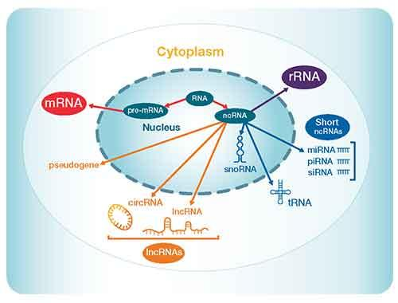
Transcriptome: RNA types
Notes:
For more details: https://www.thermofisher.com/us/en/home/life-science/sequencing/sequencing-learning-center/next-generation-sequencing-information/ngs-basics/rna-sequencing-methods.html

Slide 11
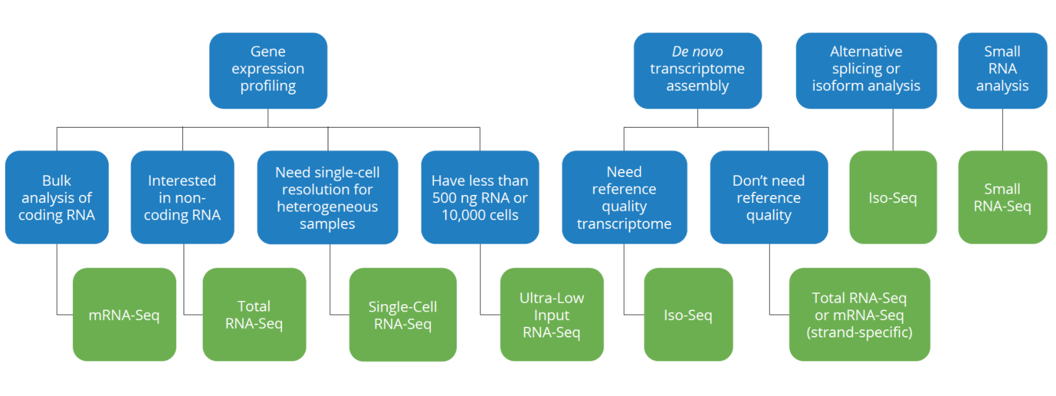
Which RNA-seq assay should I use?
From: Genewiz

Slide 12
RNA-seq – qualitative and quantitative biological insights
•Qualitative: identifying (annotating) or refining expressed transcripts, exon/intron boundaries, transcriptional start sites (TSS), and poly-A sites.
•Quantitative: measuring differences in expression, alternative splicing, alternative TSS, and alternative polyadenylation between two or more treatments or groups.
(i.e. experiment to measure differential gene expression - DGE)
https://rnaseq.uoregon.edu/#table1.1

Slide 13
Experimental design is fundamental
Which biological questions we want to answer
Coding or non coding RNA?
Why do you expect to find differentially expressed genes in the particular tissue?
How many tissue types and/or time points to compare?
What types of genes do you expect to find differentially expressed?
What are the sources of variability from your samples?
More technical questions
Which sequencing platform?
Depth of sequencing?
Pooling samples?
Biological replicates/technical replicates?
Many others...

Slide 14
Bulk RNA-seq - advantages and limitations
A major breakthrough - replaced microarrays
Measures the average expression level for each gene across a large population of input cells
To quantify expression signatures in disease studies
Insufficient for studying heterogeneous or dynamic systems, e.g. early development studies, complex tissues (brain)

Slide 15
scRNA-seq - advantages and limitations
First publication by (Tang et al. 2009)
From ~2014 new protocols and lower sequencing costs made it more accessible
Measures the distribution of expression levels for each gene across a population of cells
Allows cell type identification, studying the heterogeneity of cell responses
Currently there are several different protocols in use and commercial platforms available
Still expensive, not a gold standard as RNA-seq, small amount of material, uncertainty

Slide 16
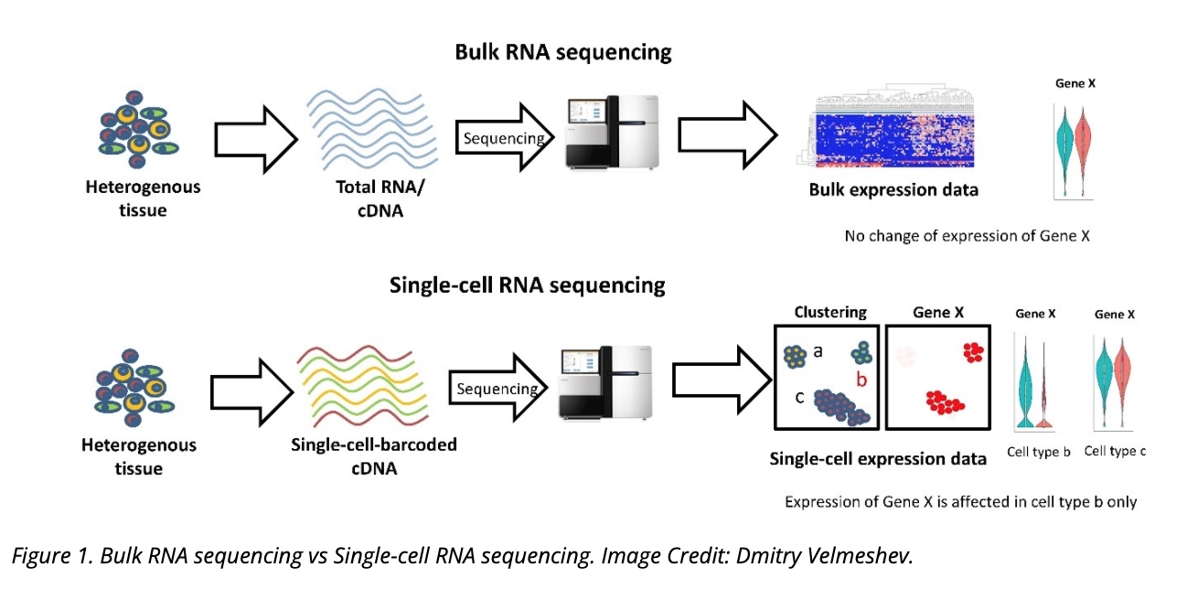
Bulk RNA-seq vs single cell (sc) RNA-seq
Single Cell RNA-seq workshop
Mid-April 2022
From: https://www.technologynetworks.com/genomics/articles/recent-advances-in-single-cell-genomics-techniques-324695
Notes:
There is another new technology called spatial transcriptomics which is somewhere in the middle of RNA-seq and single-cell RNA-seq when it comes to cellular resolution.
https://www.genengnews.com/commentary/point-of-view/single-cell-explorations-are-underway-and-spatial-is-the-next-frontier/

Slide 17
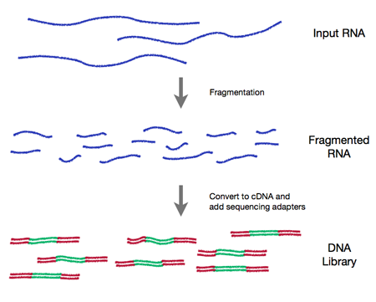
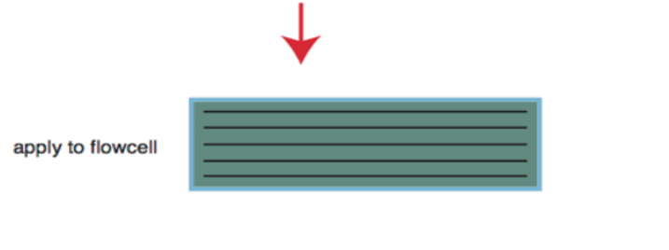
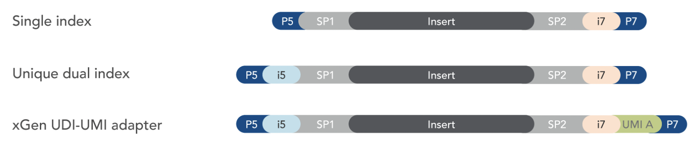
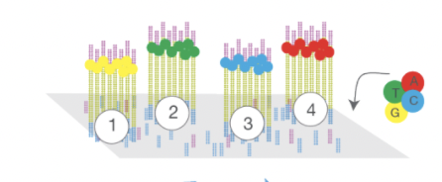
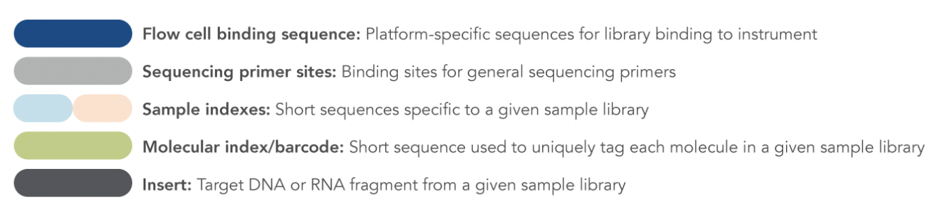
How does the technology work?
Immobilization and amplification
Text file
Notes:
Detailed information: https://rnaseq.uoregon.edu/#rna-prep-working-with-rna
From http://rockefelleruniversity.github.io/RU_RNAseq/
More details here: https://rnaseq.uoregon.edu/#rna-prep-working-with-rna
RNA quality is fundamental
RNA extraction method can affect the transcript abundance
Choice of platform and library preparation protocol
Meta-analysis of transcriptome datasets can introduce batches effects

Slide 18
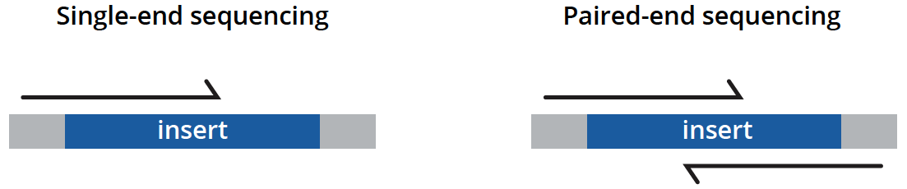
Types of sequencing
unidirectionally - sequencing from one end only
less expensive, is typically reserved for quantifying gene expression in well-annotated genomes and analyzing small RNA molecules.
bidirectionally - both ends of DNA fragments to be sequenced
usually recommended for most applications as it provides richer data and permits longer library insert sizes.
https://www.genewiz.com/
Notes:
Suggesting reading https://bmcbioinformatics.biomedcentral.com/articles/10.1186/s12859-020-3484-z

Slide 19
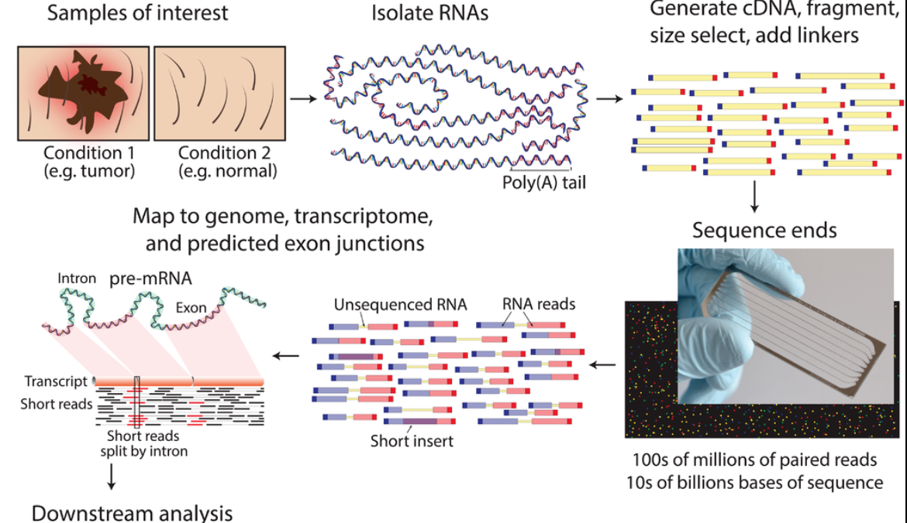
RNA-seq - experiment
mean length of 300 bp (typically ranging 200–700 bp
https://www.wikiwand.com/en/RNA-Seq

Slide 20
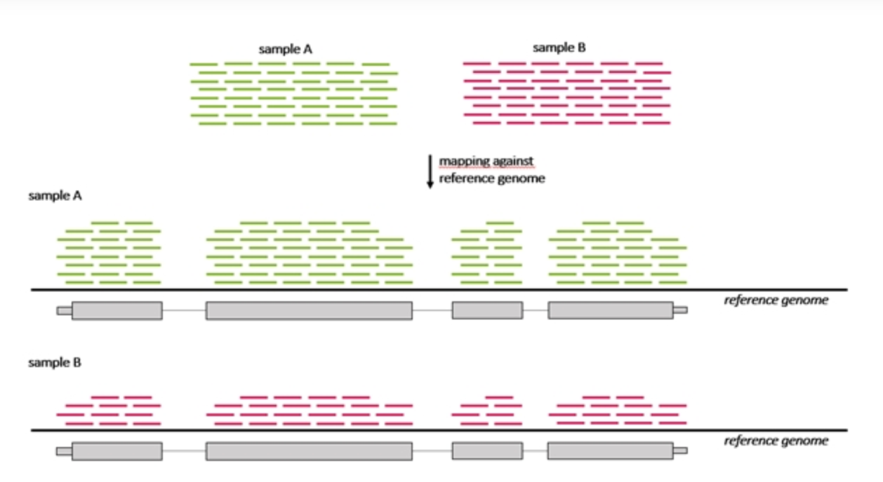
RNA-seq - differentially expressed genes (DGE)
Which genes are expressed at different levels between conditions (sample A and sample B)
Many steps to calculate the DGE between sample A and B
Source : seqme

Slide 21



RNA-seq - analysis workflow
Biological samples
Session 1: Concepts + Demo
Library preparation
Sequencer: Reads Fastq
Quality check
FastQC
Trimming
cutadapt
Quality check
FastQC
Alignment/Mapping
STAR
Quality check
Session 2: Concepts + Demo
Counting Reads
featureCounts
Quality check

Slide 22
Bioinformatics software ecosystem
Tools that “do one thing, and do it well”.
Tools for this workshop: fastqc, cutadapt, STAR, featureCounts
Available on Galaxy
Some are pre-installed on Wynton; others we can install ourselves
Download a container with all tools installed; use anywhere
Everything can be installed on a laptop
Notes:
Visit https://usegalaxy.org/ and look for these tools in the Tools shed on the left.
Login to a Wynton dev node and search for the tools using module spider

Slide 23
Different platforms for computing
Web-based platforms
Graphical User Interface
Command Line Interface
etc..
Notes:
Visit https://usegalaxy.org/ and look for these tools in the Tools shed on the left.
Login to a Wynton dev node and search for the tools using module spider

Slide 24
Galaxy: Open source, web-based platform that integrates many tools.
Free, public, internet accessible resource.
https://usegalaxy.org/
Data transfer and data storage are not encrypted.
DO NOT UPLOAD PROTECTED DATA!!!
Notes:
Galaxy provides a collection of tools to analyze variety of biomedical data
https://usegalaxy.org/

Slide 25
Command line interfaces allow scripting
Graphical User Interface
Consists of windows, icons, menus, pointers
Not always available for bioinformatics
Command Line Interface
Text based
Allow automation by scripting
Examples
Wynton CLI
MacOS: Terminal
Windows: Command Prompt, PuTTY

Slide 26
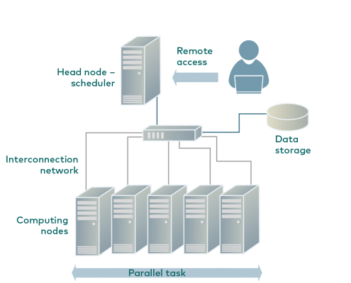
Wynton is a high-performance computing (HPC) system for UCSF affiliates
How to access Wynton? Visit:
https://wynton.ucsf.edu/hpc/get-started/access-cluster.html
Most universities/ institutions doing data-intensive science have HPC cluster on campus.
(see Description for image source)
Notes:
Image taken from https://hpc.rtu.lv/introduction-to-hpc/?lang=en

Slide 27
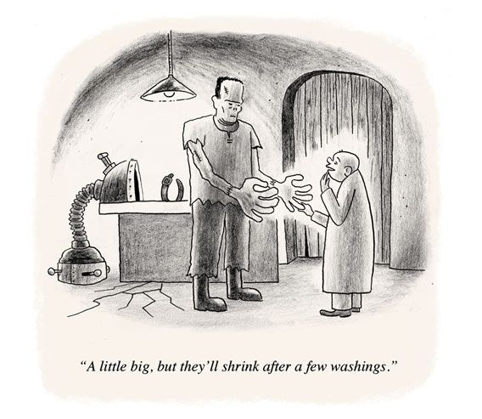
Containers enable reproducibility
Tools are constantly under development
=> Many versions around
Dependencies complicate installations
Dependencies are also constantly under development
=> Many versions around
Different labs use different programming languages

Slide 28
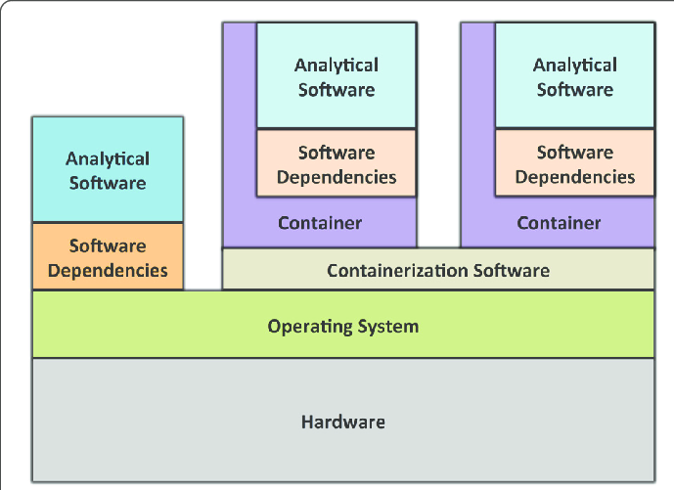
A container is like a computer within a computer
Containerization software examples:
Singularity
Docker (has security issues in the context of HPC)
Containers can be deployed on commercial cloud computing platforms, e.g., Amazon Web Services
(see Description for image source)
Notes:
Image source: https://gigascience.biomedcentral.com/track/pdf/10.1186/s13742-016-0135-4
Paper introducing Singularity: https://journals.plos.org/plosone/article/file?id=10.1371/journal.pone.0177459&type=printable

Slide 29
Best to use singularity with Linux (currently)
Limited support for MacOS
Even more limited support for Microsoft Windows

Slide 30
Poll Question
Do you have a UCSF Wynton account?
Yes
No

Slide 31
RNA-seq - analysis workflow
Biological samples
Session 1: Concepts + Demo
Library preparation
Sequencer: Reads Fastq
Quality check
FastQC
Trimming
cutadapt
Quality check
FastQC
Alignment/Mapping
STAR
Quality check
Session 2: Concepts + Demo
Counting Reads
featureCounts
Quality check

Slide 32
Example FASTQ file with one read only.
Open Single_read.fastq

Slide 33
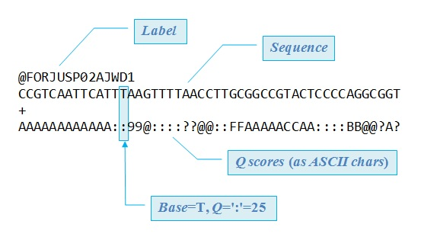
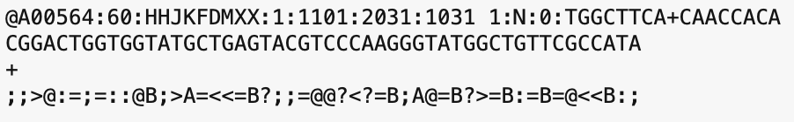
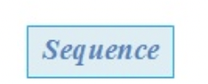
FASTQ files are text files with detailed information about each read.
Image adapted from Robert Edgar's web site https://www.drive5.com/

Slide 34
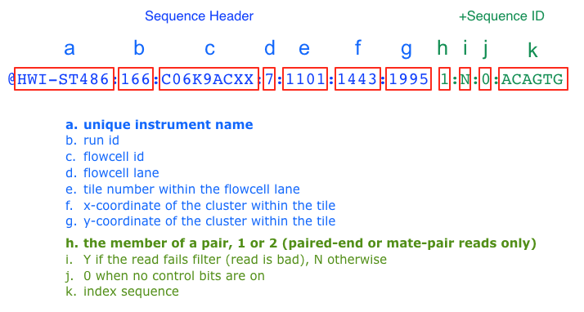
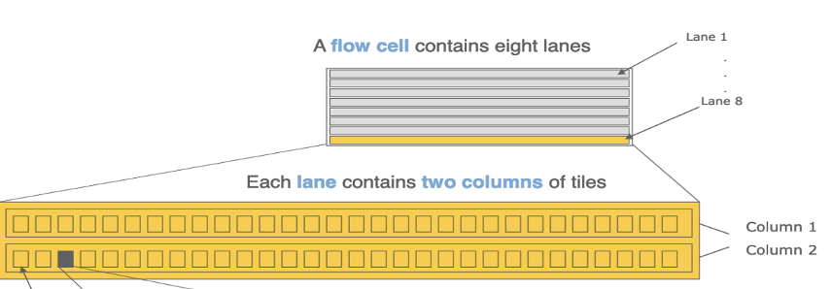
Label format in FastQ file
The more recent versions of Illumina software output a sample number (as taken from the sample sheet) in place of an index sequence (k).
Notes:
Suggested reading:
https://help.basespace.illumina.com/articles/descriptive/fastq-files/

Slide 35
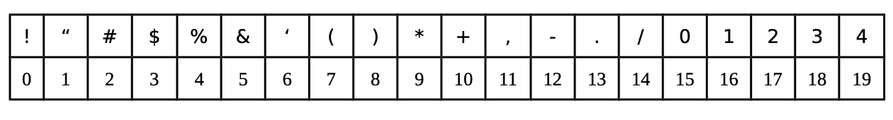
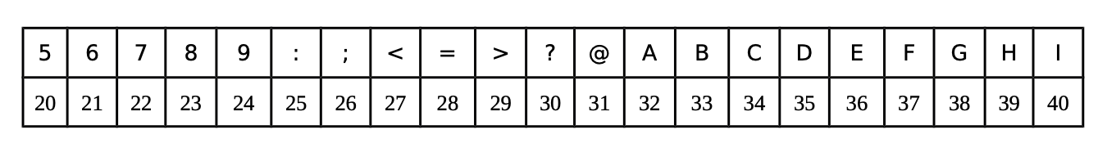
Quality score of each base
Each symbol is a probability p that the base call is incorrect.
The standard Sanger sequencing score to assess reliability of a base call is Q=−10 log10(p)
p, the probability that a given base is incorrectly called
A quality score of 20 (Q20) represents an error rate of 1 in 100 (meaning every 100 bp sequencing read may contain an error), with a corresponding call accuracy of 99%.
Notes:
https://www.illumina.com/science/technology/next-generation-sequencing/plan-experiments/quality-scores.html

Slide 36
FASTQ files are text files with detailed information about each read.
Image adapted from Robert Edgar's web site https://www.drive5.com/

Slide 37
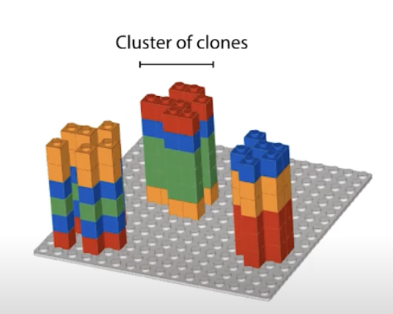
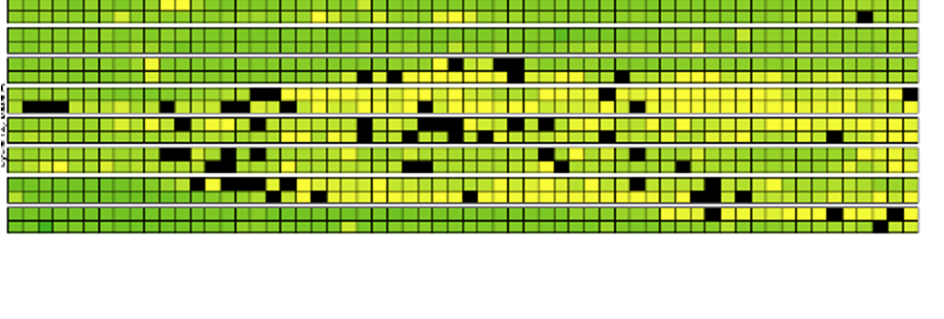


Base calling may not be accurate
Possible causes
Blocking of synthesis after one nucleotide addition may be inefficient.
Clusters might not be monoclonal.
A tile may be out of focus.
Oil, reagent, etc. on flow cell or imaging component, etc.
=> Need to record quality of each base call.
Notes:
https://www.youtube.com/watch?v=U4QnpciIJhM

Slide 38
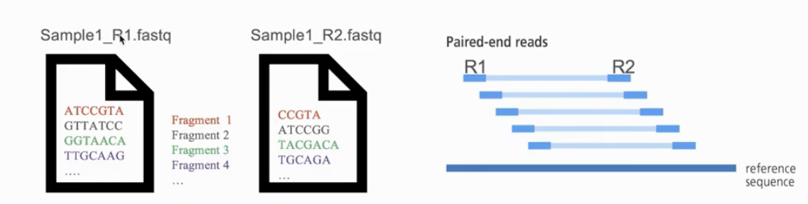
Naming conventions for fastq files
File names often follow a format.
SampleName_SampleNumber_LaneNumber_ReadNumber_SetNumber.fastq
Eg – Bacteria_S1_L001_R1_001.fastq
Paired-end reads named with R1 and R2 in file name.
Eg – Bacteria_GATTACA_L001_R1_001.fastq and Bacteria_GATTACA_L001_R2_001.fastq
File extensions may be .fq or even .txt
Often compressed using gzip.
gzip is free and open-source.
Resulting file names have .gz added. Example – .fq.gz.
Notes:
File names samplename_S1_L001_R1_001.fastq.gz
samplename—The sample name provided in the sample sheet. If a sample name is not provided, the file name includes the sample ID, which is a required field in the sample sheet and must be unique.
S1—The sample number based on the order that samples are listed in the sample sheet starting with 1. In this example, S1 indicates that this sample is the first sample listed in the sample sheet.
L001—The lane number.
R1—The read. In this example, R1 means Read 1. For a paired-end run, there is at least one file with R2 in the file name for Read 2.
001—The last segment is always 001

Slide 39
Knowledge check
What is the flow cell id in the fastq file below?
@SIM:1:FCX:1:15:6329:1045 1:N:0:2
TCGCACTCAACGCCCTGCATA
+
<>;##=><9=AAAAAAAAA9#
15
FCX
#
SIM

Slide 40
Knowledge check
What is the Q-score (ASCII) of the 3rd base?
@SIM:1:FCX:1:15:6329:1045 1:N:0:2
TCGCACTCAACGCCCTGCATA
+
<>;##=><9=AAAAAAAAA9#
G
>
;
I
None of the above

Slide 41
RNA-seq - analysis workflow
Biological samples
Session 1: Concepts + Demo
Library preparation
Sequencer: Reads Fastq
Quality check
FastQC
Trimming
cutadapt
Quality check
FastQC
Alignment/Mapping
STAR
Quality check
Session 2: Concepts + Demo
Counting Reads
featureCounts
Quality check

Slide 42
Galaxy registration and login (https://usegalaxy.org/login)
Wynton login
(Mac Terminal / Windows Command Prompt)
Need help - please drop a question in the chat or speak up

Slide 43
Break (10 min)

Slide 44
RNA-seq - analysis workflow
Biological samples
Session 1: Concepts + Demo
Library preparation
Sequencer: Reads Fastq
Quality check
FastQC
Trimming
cutadapt
Quality check
FastQC
Alignment/Mapping
STAR
Quality check
Session 2: Concepts + Demo
Counting Reads
featureCounts
Quality check

Slide 45
FastQC: Quality check of sequencing data
Summarizes quality of base calls
Any sequences more frequently observed than expected?
Any sequence biases?
Any GC biases?
Checks for presence of known adapters
Notes:
For more: https://rtsf.natsci.msu.edu/genomics/tech-notes/fastqc-tutorial-and-faq/

Slide 46
Examples of FastQC reports
Good Illumina data: https://www.bioinformatics.babraham.ac.uk/projects/fastqc/good_sequence_short_fastqc.html
Bad Illumina data: https://www.bioinformatics.babraham.ac.uk/projects/fastqc/bad_sequence_fastqc.html

Slide 47
What if QC gives warn/fail flag?
Non-normal GC content per read?
Normal expected for whole-genome shotgun sequencing.
RNA-seq might give different distributions.
Non-uniform sequence content per nucleotide?
First 10-15 nt in RNA-seq often non-uniform.
High duplication levels or overrepresented sequences?
Are they contaminants, e,g. adapters or PCR duplicates?
If so, clean up contaminants.
Could be attributed to highly abundant transcripts.

Slide 48
Demo
Login to Galaxy/Wynton
Uploading FASTQ files to Galaxy/Wynton
Running FASTQC
Checking the adapter content
Notes:
Steps for Galaxy:
1. Go to https://usegalaxy.org/login and login. Please make sure you activate your account before running the analysis. For activation, you should receive an email from Galaxy.
2. Click on “Upload data” option in the Tools panel on the left. In the window that opens, click on “Choose local files” and upload Bacteria_GATTACA_L001_R1_001.fastq to Galaxy by selecting it from your computer and pressing “Start”.
3. Search for the FASTQC tool in Galaxy using the Tools panel on the left.
4. Select FastQC from the options.
5. Under the “Short read data from your current history”, our uploaded data should be selected automatically.
6. Click on ”Execute”.
7. Since Galaxy is a freely available tool, it is used by many researchers around the world. It may take some time for the results to be available.
8. When the execution is finished, results will be visible (highlighted in green) in the History panel on the right. You can view them by clicking on the eye icon next to each resulting file name.
Similar steps of searching for tools in the left panel, viewing the intermediate results by clicking on the eye icon in the right-side History panel, and selecting data files as input in the central panel can be used for subsequent steps.
Suggested reading:
https://training.galaxyproject.org/training-material/topics/transcriptomics/tutorials/ref-based/tutorial.html
For Wynton, the script is available in the workshop materials:
#Tutorial to login to wynton: https://wynton.ucsf.edu/hpc/get-started/access-cluster.html
#Tutorial for wynton development nodes: https://wynton.ucsf.edu/hpc/get-started/development-prototyping.html
#file transfer tutorial: : https://wynton.ucsf.edu/hpc/transfers/files-and-directories.html

Slide 49
Dataset
Small dataset with 100k reads (for practice only).
FASTQ to tallying counts.
Analysis of real datasets can take time. Real sequenced read libraries can be found online https://www.ncbi.nlm.nih.gov/sra/.
The practice dataset has a low number of reads, which is not meaningful for differential gene expression analysis. Hence, for differential gene expression analysis use a real counts matrix, an example of which can be found at https://www.ncbi.nlm.nih.gov/geo/query/acc.cgi?acc=GSE49712.

Slide 50
Poll
Where should we do the remaining demo?
Galaxy
Wynton
No preference

Slide 51
Session 1: Take-home messages
Define your hypothesis and datasets before planning RNA-seq experiment
Each steps of the analysis can be affected by some kind of bias - Check the quality after each step!
Be familiar with file formats
Biological samples
Library preparation
Sequencer: Reads Fastq
Quality check
FastQC
Trimming
cutadapt
Quality check
FastQC
Session 2
Alignment/Mapping
STAR
Quality check
Please take the survey:
https://www.surveymonkey.com/r/F75J6VZ
Counting Reads
featureCounts
Quality check

Slide 52
Working material for this workshop
Single_read.fastq
Bacteria_GATTACA_L001_R1_001.fastq
Adapter_Sequence.fasta
rDNA_sequence.fasta
rDNA.gtf
all_steps.sh
Please register on Galaxy, activate account and login!
https://usegalaxy.org/login
If you have an account on UCSF Wynton HPC cluster please try to login using instructions at https://wynton.ucsf.edu/hpc/get-started/access-cluster.html

Slide 53
Introduction to RNA-seq data analysis
Michela Traglia, Ayushi Agrawal
Bioinformatics Core, GIDB
March 10-11, 2022

Slide 54
Session 2
Tools: Galaxy, UCSF Wynton, cutadapt, STAR, featureCounts

Slide 55
Workshop outline
Session 1
RNA-seq experiments and protocols overview
Introduction to HPC and Galaxy
Understanding the sequencer output
Break
Concepts and Demo: steps from sequencer output to FastQC
Session 2
Concepts and Demo
From FastaQC to Trimming
Mapping to reference genome
Break
Annotation to genomic features
Additional resources

Slide 56
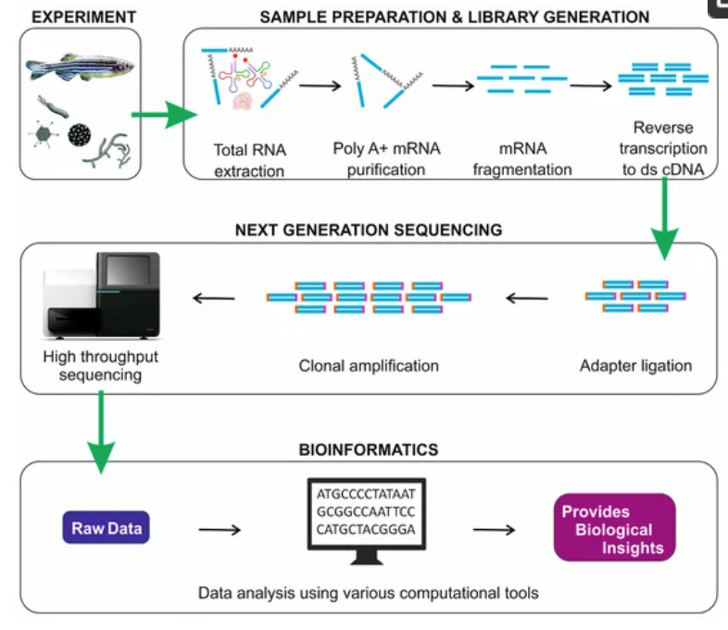
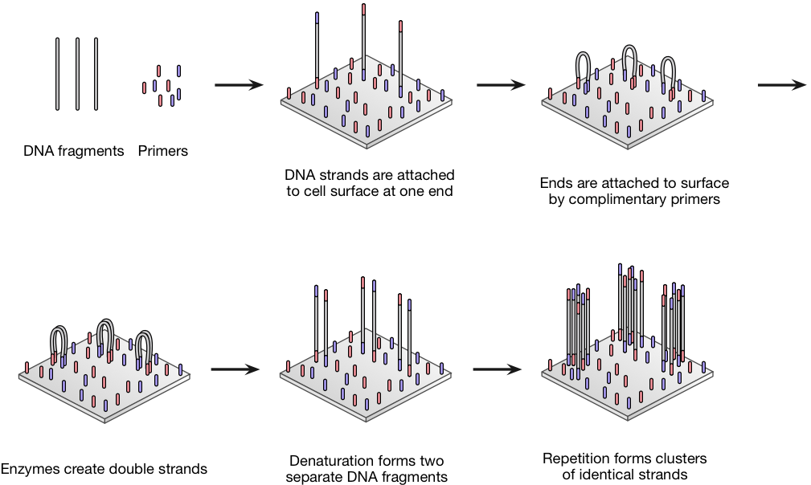
RNA-seq - overview
Single_read.fastq
Bacteria_GATTACA_L001_R1_001.fastq
From https://doi.org/10.3390/ijms19010245

Slide 57
Typical command line syntax of bioinformatics tools
$ Toolname –a 10 –b file.txt –c xyz.fq –o pqrs.tuv
$ Toolname --paramA 10 –b file.txt –c xyz.fq –outFile pqrs.tuv
Examples:
$ fastqc –t 16 –o ./ Bacteria_GATTACA_L001_R1_001.fastq
$ fastqc *.fastq
$ cutadapt –a GATTACA –o ./trimmed.fastq input.fastq

Slide 58
Examples of commands to execute various steps
Trimming adapters
$ cutadapt \
> –a file:Adapter_Sequence.fasta \
> –o ./trimmed.fastq Bacteria_GATTACA_L001_R1_001.fastq
Similarly for other tools

Slide 59
Typical command line syntax with singularity container
$ singularity exec containername Toolname –a 10 –b file.txt –c xyz.fq –o pqrs.tuv
Examples:
$ singularity exec rna_seq_container.sif fastqc –t 16 –o ./ Bacteria_GATTACA_L001_R1_001.fastq

Slide 60
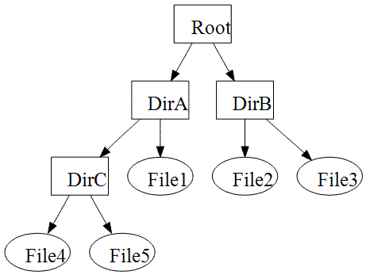
File paths := Location of file on computer
Lots of files on a computer
Organized in directories which may contain sub-directories
Bioinformatics tools may need file inputs and may output files
Where are the input files located on the computer?
Searching entire computer not practical
What if multiple files have the same name?
Where should the output files be saved?
Notes:
Command line cheat sheet
https://www.git-tower.com/blog/command-line-cheat-sheet/

Slide 61
File paths
./ is for current working directory
../ is for parent directory of current working directory
../../ is for parent directory of parent directory of current working directory
/Root/DirA/DirC/File4 is the path of File4 in the image to the right.

Slide 62
Knowledge check
What is the sequence length reported by the FASTQC run yesterday?
100000
50
0

Slide 63
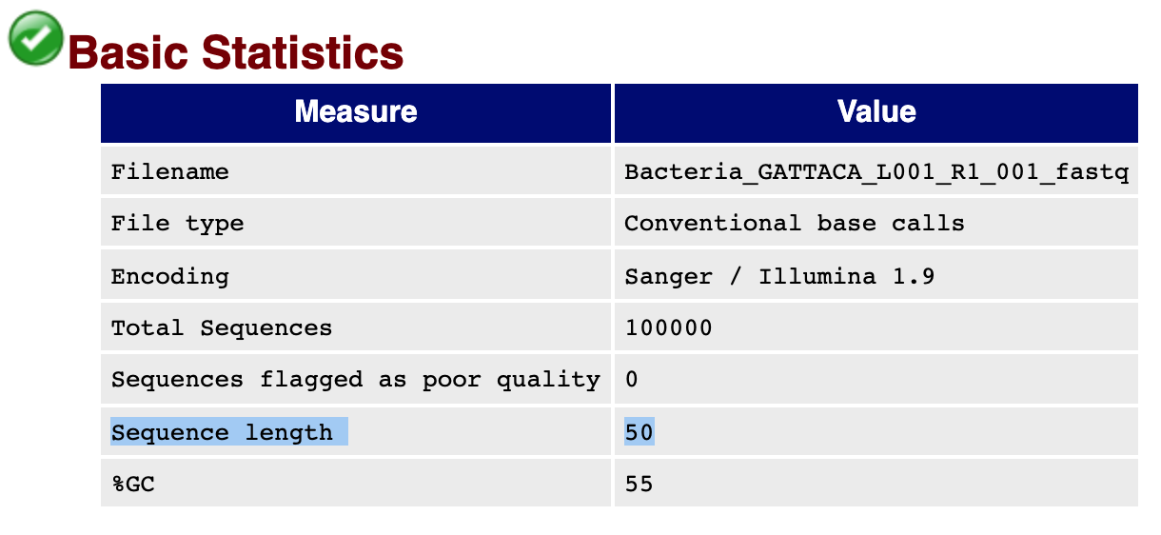
Knowledge check
What is the sequence length reported by the FASTQC run yesterday?
100000
50
0

Slide 64
RNA-seq - analysis workflow
Biological samples
Session 1: Concepts + Demo
Library preparation
Sequencer: Reads Fastq
Quality check
FastQC
Trimming
cutadapt
Quality check
FastQC
Alignment/Mapping
STAR
Quality check
Session 2: Concepts + Demo
Counting Reads
featureCounts
Quality check

Slide 65
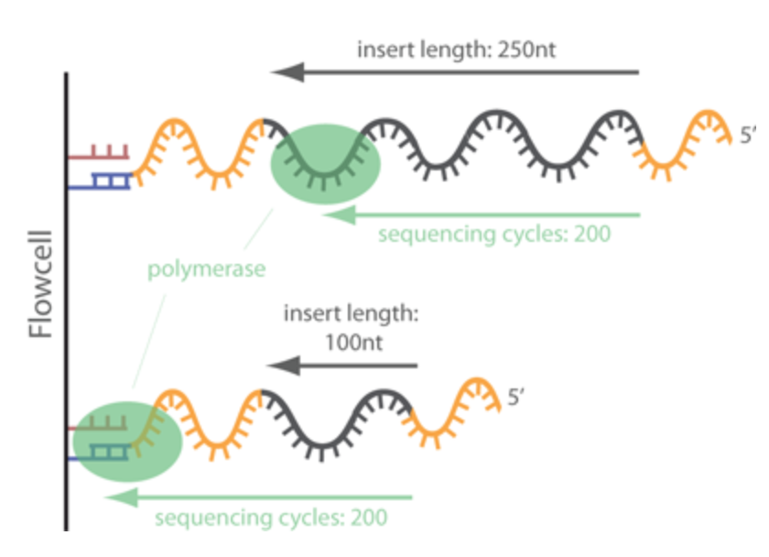
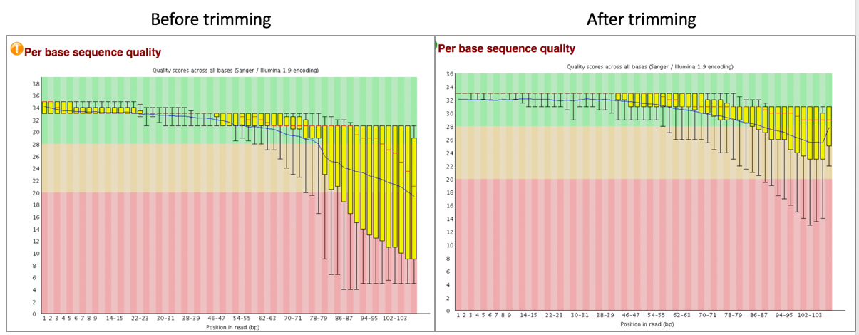
Trimming - Removing adapters
Tools: cutadapt, Trimmomatic
Notes:
https://www.ecseq.com/support/ngs/trimming-adapter-sequences-is-it-necessary

Slide 66
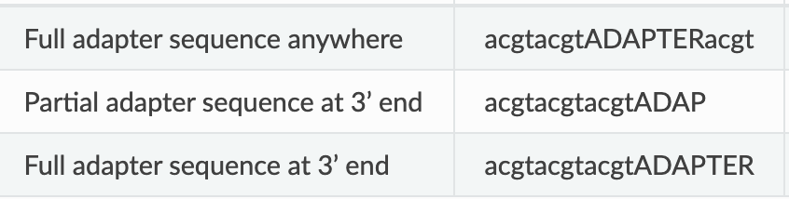
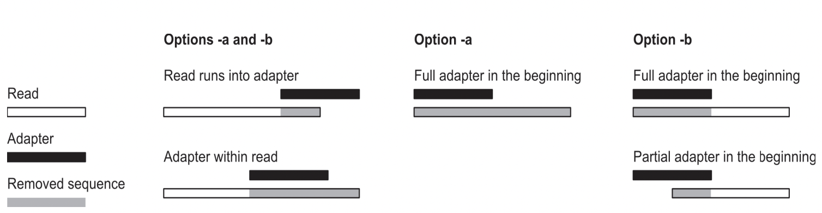

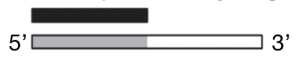
cutadapt removes adapters
Search for adapter sequence in read.
Allow for mismatches in sequence.
If significant alignment, cut.
5’
3’
5’
3’
5’
3’
5’
3’
Forward read ->
Aligned region
5’
3’
Min error rate
Max overlap
<- Reverse read

Slide 67
Redo QC to ensure satisfactory quality
Run FastQC.
Is the adapter content gone?

Slide 68
Demo
Login to Galaxy/Wynton
Run cutadapt to trim adapters
Run FASTQC - is the adapter content gone?
Notes:
Steps on Galaxy:
1. 3’ prime adapter sequences are available in Adapter_Sequence.fasta. Upload it to Galaxy using the upload data button, which should be visible in the Tools panel at the top.
2. Search for cutadapt in the Tools panel on the left.
3. Under the “FASTQ/A file”, select the previously uploaded raw sequence file Bacteria_GATTACA_L001_R1_001.fastq.
4. Under the “Read 1 Options”, click on the button “+ Insert 3' (End) Adapters”. Under source, select “File from history” and under “Choose file containing 3' adapters” select the Adapter_Sequence.fasta.
5. In “Filter Options”, for “Minimum length”, enter 20.
6. In “Read Modification Options”, for “Quality cutoff”, enter 20.
7. In “Output Options”, check “Yes” for “Report”
8. Click Execute.

Slide 69
RNA-seq - analysis workflow
Biological samples
Session 1: Concepts + Demo
Library preparation
Sequencer: Reads Fastq
Quality check
FastQC
Trimming
cutadapt
Quality check
FastQC
Alignment/Mapping
STAR
Quality check
Session 2: Concepts + Demo
Counting Reads
featureCounts
Quality check

Slide 70
Alignment/Mapping
Aligning reads to regions of reference DNA.
Assumption: After cleaning, reads from real sample only.
Strategies for assembly:
Reference genome
De novo assembly
Tools: STAR, HISAT2, TopHat2, bowtie2, salmon, kallisto

Slide 71
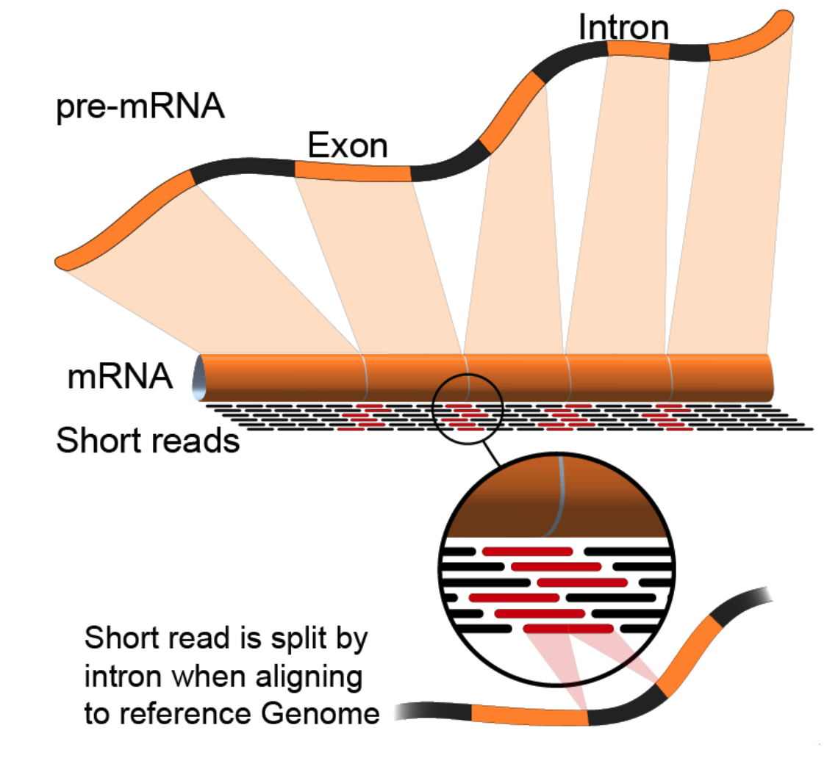
Alignment to genome : challenges
Reads from junctions: one part of it maps to one exon and the other half maps to the other exon
Reference sequences can be very long (~3 billion bp for humans).
Order of 100 million reads to be mapped.
Need to account for splicing.
Allow for PCR artifacts/sequencing errors.
Notes:
Suggested reading:
https://www.ncbi.nlm.nih.gov/pmc/articles/PMC3322381/pdf/nihms-366740.pdf
https://academic.oup.com/bioinformatics/article/29/1/15/272537
Video lectures on how these mapping tools work:
https://www.youtube.com/watch?v=hpb-mH-yjLc&list=PL2mpR0RYFQsBiCWVJSvVAO3OJ2t7DzoHA

Slide 72
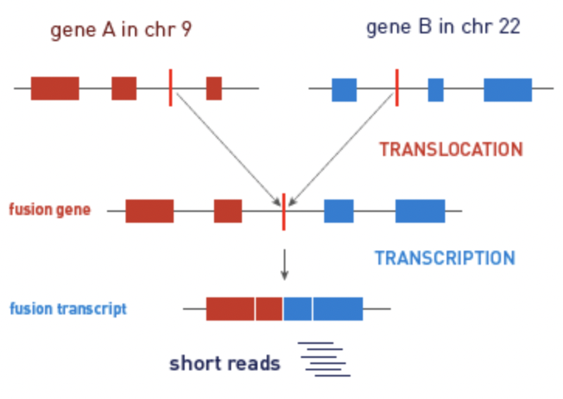
Alignment/Mapping: STAR tool
STAR (Spliced Transcripts Alignment to a Reference (STAR))
is popular for RNA-Seq data because it
does unbiased de novo detection of canonical junctions
can discover non-canonical splices
can discover chimeric (fusion) transcripts

Slide 73
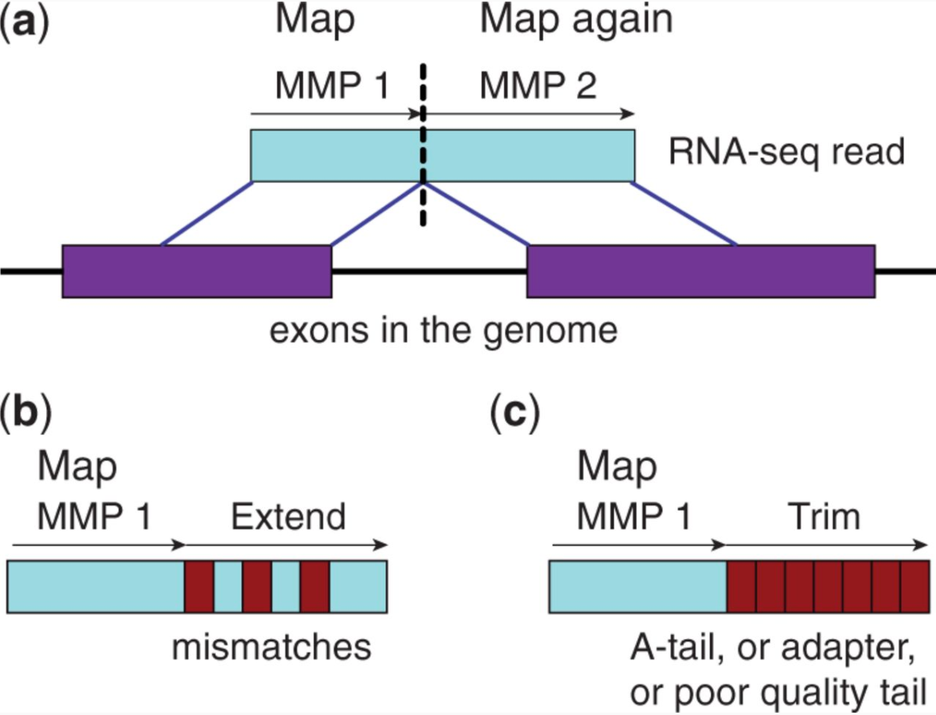
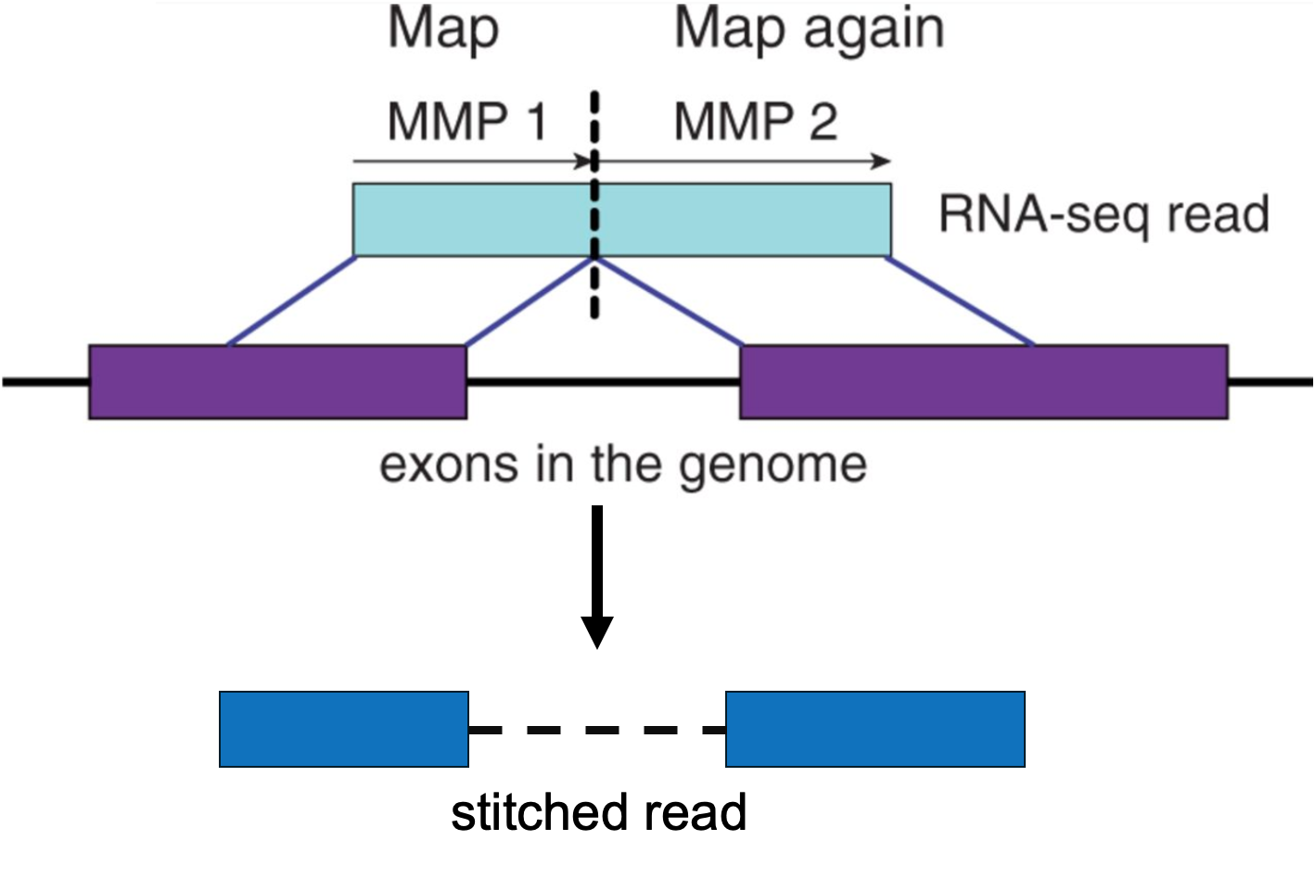
Alignment/Mapping: How does STAR work?
Step 1: Seed search
Step 2: Stitching and scoring
MMP = Maximum Mappable Prefix
Image source: STAR's seed search (Figure 1 from Dobin et al. 2013)
Notes:
https://www.ncbi.nlm.nih.gov/pmc/articles/PMC3530905/

Slide 74
Alignment/Mapping: Inputs needed
Reads to align
FASTQ file after cleaning (trimming adapters).
Reference sequence to align to
Example – “rDNA_sequence.fasta”
FASTA format. Two lines per sequence.
Starting with “>”, followed by sequence name/identifier.
Sequence.
File extensions: .fasta, .fa, .txt.
Examples of acceptable genome sequence files for STAR:
ENSEMBL: files marked with .dna.primary.assembly
GENCODE: files marked with PRI (primary). Strongly recommended for mouse and human.
Notes:
Examples of acceptable genome sequence files:
ENSEMBL: files marked with .dna.primary.assembly, such as: ftp://ftp.ensembl. org/pub/release-77/fasta/homo_sapiens/dna/Homo_sapiens.GRCh38.dna.primary_ assembly.fa.gz
GENCODE: files marked with PRI (primary). Strongly recommended for mouse and human: http://www.gencodegenes.org/.

Slide 75
Demo on Galaxy/Wynton
Login to Galaxy/Wynton
Run STAR to align the reads to the reference genome
Notes:
Steps for Galaxy:
Search for STAR in Tools panel on the left.
Upload rDNA_sequence.fasta to Galaxy using the load data icon, which should be visible in the Tools panel at the top.
Use the output from cutadapt as input under the field “FATA/Q file” in the central panel.
Under “Will you select a reference genome from your history or use a built-in index?” select “Use a genome from history and build index”. Then, select rDNA_sequence.fasta as “the reference genome” in the next field.
Press Execute.
The output should be available as a SAM or BAM file.

Slide 76
Break (10 min)
Need help? Please drop a question in the chat or speak up
Please take the survey:
https://www.surveymonkey.com/r/F75J6VZ

Slide 77
Understanding STAR output
1. Alignments in SAM format
2. Summary of mapping statistics
How many reads mapped?
How many unmapped?
...

Slide 78
Sequence Alignment/Map (SAM) format
Open with Excel.
First few lines contain metadata about alignments.
These lines start with “@”.
Example – version of file format, sorting order of alignments, grouping, etc.
After header, a table of alignments.
Alignment reports often very large files.
Binary Alignment/Map (BAM) extension used for compressed SAM files.
Notes:
Suggested reading:
https://samtools.github.io/hts-specs/SAMv1.pdf

Slide 79
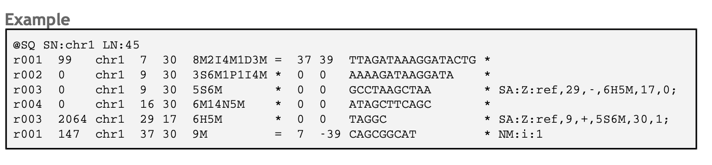
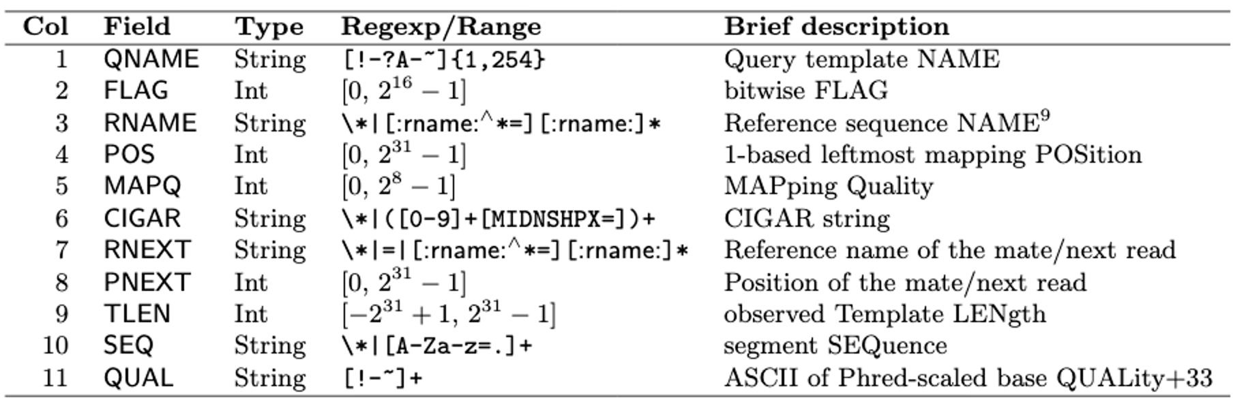
SAM format
Notes:
Suggested reading:
https://samtools.github.io/hts-specs/SAMv1.pdf
https://broadinstitute.github.io/picard/explain-flags.html
https://www.samformat.info/sam-format-flag

Slide 80
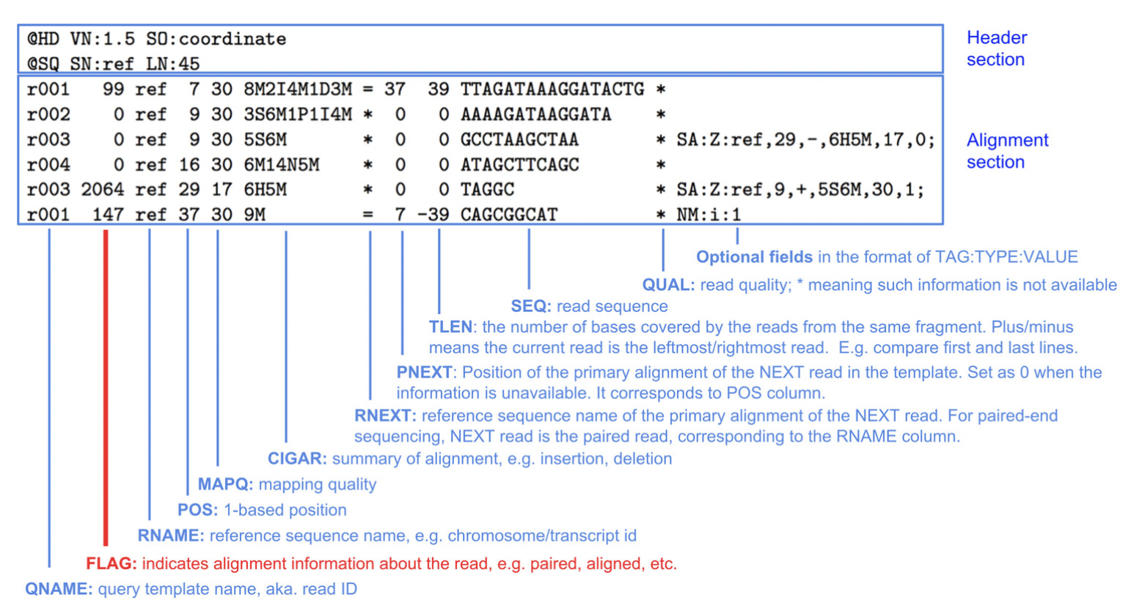
SAM format

Slide 81
Demo on Galaxy/Wynton
Inspect the STAR output
How do the output files look?

Slide 82
Alternative tools
Many. Example – STAR, HISAT2, TopHat2, bowtie2, salmon, kallisto, etc.
Differences in speed and memory requirement.
Pros and cons of each:
Example: Some handle spliced alignment, others do not.
…
Notes:
Suggested reading:
https://www.ncbi.nlm.nih.gov/pmc/articles/PMC3322381/pdf/nihms-366740.pdf

Slide 83
Tools to manipulate files are available
Need to sort alignment report?
samtools
Need to convert FASTQ to FASTA?
fastx-toolkit
…
Google!

Slide 84
RNA-seq - analysis workflow
Biological samples
Session 1: Concepts + Demo
Library preparation
Sequencer: Reads Fastq
Quality check
FastQC
Trimming
cutadapt
Quality check
FastQC
Alignment/Mapping
STAR
Quality check
Session 2: Concepts + Demo
Counting Reads
featureCounts
Quality check

Slide 85
Knowledge check
Which information do you find in a SAM/BAM file?
Sequences, like a FASTQ file
Location of the read on the chromosome
Mapping quality
All of the above

Slide 86
Knowledge check
Which information do you find in a SAM/BAM file?
Sequences, like a FASTQ file
Location of the read on the chromosome
Mapping quality
All of the above

Slide 87
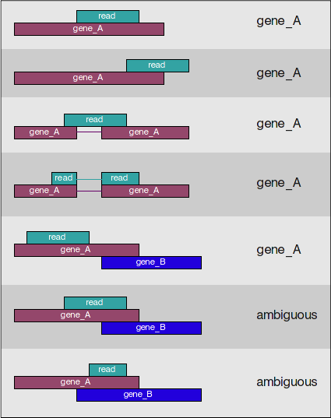
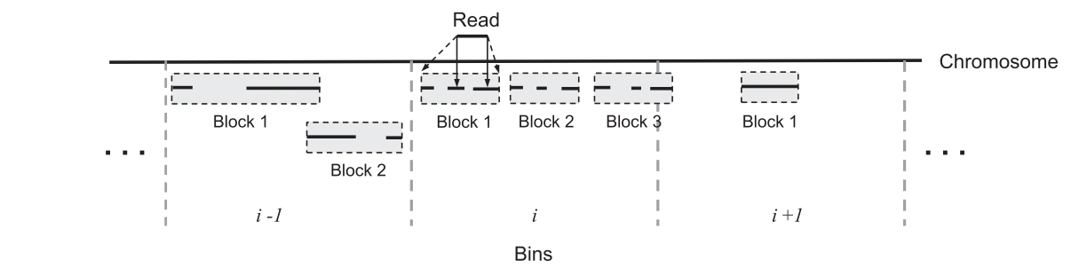
How many reads overlap annotated regions?
Need annotation information
Need alignment information
Use featureCounts
Notes:
Suggested reading:
https://academic.oup.com/bioinformatics/article/30/7/923/232889

Slide 88
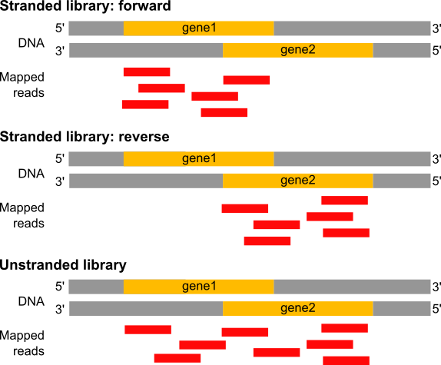
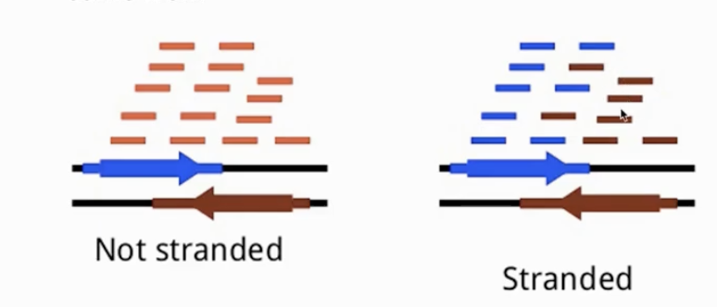
Estimation of the strandness
In a stranded forward library, reads map mostly on the genes located on forward strand (here gene1).
With stranded reverse library, reads map mostly on genes on the reverse strand (here gene2).
With unstranded library, reads maps on genes on both strands.
Image source: https://training.galaxyproject.org/training-material/
Notes:
Suggested reading:
https://www.ncbi.nlm.nih.gov/pmc/articles/PMC3005310/
https://blog.genewiz.com/stranded-vs-non-stranded-rna-seq

Slide 89
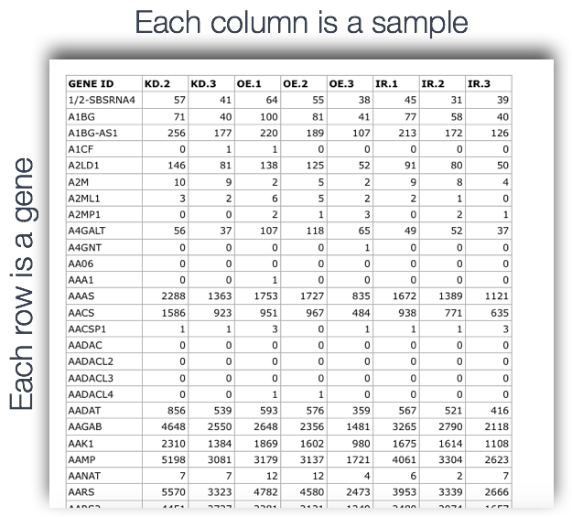
featureCounts input/output
Input:
BAM file
GTF file
Output:
count matrix (text file)
a summary file

Slide 90
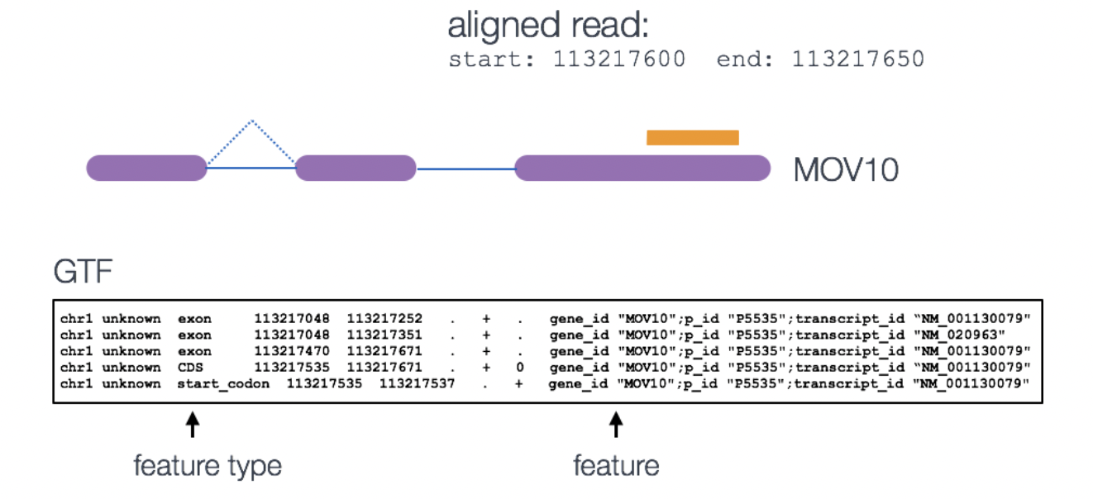
Annotation GTF format
Gene Transfer Format

Slide 91
Demo on Galaxy/Wynton
Login to Galaxy/Wynton
Run featureCounts to tally counts
Notes:
Steps for Galaxy:
1.Search for featureCounts in Tools panel.
2.Upload rDNA.gtf to Galaxy as described before.
3.Under Alignment file, select the STAR SAM file output.
4.For Gene Annotation file, select “in your history”.
5.Then, select rDNA.gtf as the input for Gene Annotation file.
6. In “Advance options”, for “GFF feature type filter”, type CDS.
7. Click Execute

Slide 92
RNA-seq - analysis workflow
Biological samples
Session 1: Concepts + Demo
Library preparation
Sequencer: Reads Fastq
Quality check
FastQC
Trimming
cutadapt
Quality check
FastQC
Alignment/Mapping
STAR
Quality check
Session 2: Concepts + Demo
Counting Reads
featureCounts
Quality check

Slide 93
RNA-seq - differentially expressed genes (DGE)
Which genes are expressed at different levels between conditions (sample A and sample B)
Many steps to calculate the DGE between sample A and B
Source : seqme

Slide 94
Gene-wise counts should be normalized before comparing between samples
Library size: counts can differ because of different library sizes (Sample A and Sample B)
Real change in expression level of a gene vs non-biological reasons
Need to estimate variability (dispersion)
Several steps and specific tools
Intermediate RNA-seq workshop
March 21, 2022 9a-12p
Please register!

Slide 95
Session 2 - Take-home messages
Each steps of the analysis can be affected by some kind of bias - Check the quality after each step!
Be aware of possible batch effects, non biological variability.
Know the tools and how they work. Use best practices for the analysis.
This workshop covered:
Common tools, e.g., fastqc, cutadapt, STAR
Common file formats, e.g., FASTQ, FASTA, SAM, GTF, BAM
Analysis with Galaxy and Wynton

Slide 96
Real data is complex
This workshop provides an introduction to typical RNA-seq analysis steps using an artificial dataset. Real data might need additional analyses choices.
Possible challenges with real data: (What we did not cover today)
What to do you if only 50%of reads align to reference?
What to do if FastQC reports unusual GC content?
What to do if the reference genome is incomplete?
How to deal with more complicated experimental designs?
How many replicates to use for RNA-seq?
Some analysis choices need experience. Consult with the Gladstone Bioinformatics core for such scenarios and data.
Notes:
E.g: The argument choices available for STAR

Slide 97
When I need help, which I do need on a daily basis,
I visit:
Slack channel for Wynton users
ucsf-wynton.slack.com
http://seqanswers.com/forums/
https://www.biostars.org/
https://www.rna-seqblog.com/
https://stackexchange.com/
Google groups for specific tools
GitHub issues
…

Slide 98
Helpful resources
Wynton slack channel
ucsf-wynton.slack.com
Gladstone Bioinformatics Core slack channel
https://gladstoneinstitutes.slack.com/archives/C0145F1L7QS
Wynton tutorials
https://github.com/ucsf-wynton/tutorials/wiki

Slide 99
How much programming skills do we need for bioinformatics?
Minimum essential
Introductory R
Introductory command line (link to a cheatsheet in speaker notes)
Available at
Gladstone Data Science Training program
Data Science workshops from the UCSF library
For RNA-seq data analysis beyond tallying gene-wise counts:
Intermediate RNA-seq
Pathway analysis
Notes:
https://www.git-tower.com/blog/command-line-cheat-sheet/

Slide 100
Thank you!
Please take the survey:
https://www.surveymonkey.com/r/F75J6VZ
Other resources
RNA-seq and analysis
RNA-seq review
RNA-seqlopedia
Galaxy tutorial

Slide 101
Upcoming workshop at Gladstone:
March 21 | Intermediate RNA-seq analysis
Mid-April | Single Cell RNA-Seq Session 1-4
Data Science Training Program

Slide 102


